Slide 1
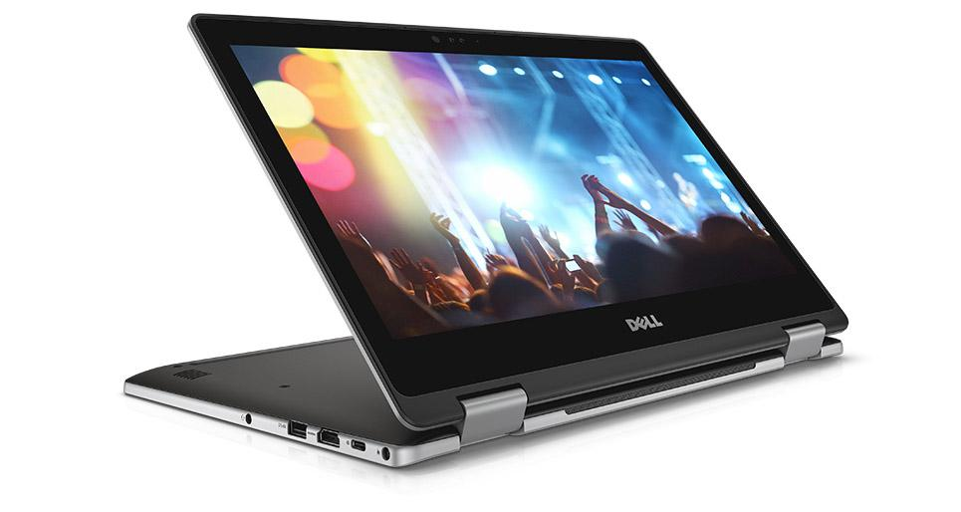
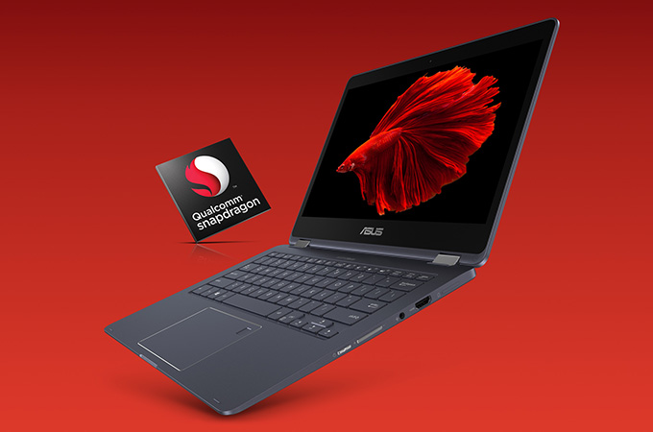
Sources: - https://goo.gl/wGpB2g (picture) - https://goo.gl/6V424V (picture)
Laptop Comparisons ...the epic fight for the glorious computer...
Kaito Tsumi and Nishant Srivastava

Slide 2
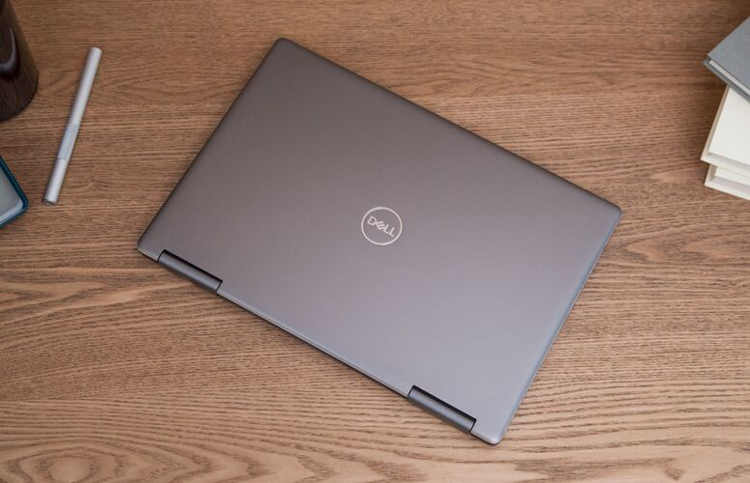
Computer A’s Description (Kaito)
Sources: - https://goo.gl/uLxMv2 (info)
Computer A - Inspiron 13 7000 2-in-1
Good for college use and school work
Touch screen
Keyboard is water resistance
RAM is better than average computer
Can perform multi-tasks

Slide 3
Computer B’s Description (Nishant)
Sources: - https://goo.gl/bnzEbK (info) - https://goo.gl/jpZoHt (Info)
Computer B - ASUS NovaGo TP370QL
General use (such as school work and watching videos) along with playing games.
Comes with Windows, however, this’ll be changed to Linux (more specifically, Ubuntu). This is to keep all information stored on the laptop private whereas if you used Microsoft, it’d be homed to Microsoft. Security is another issue where Ubuntu just obliterates Windows’ operating system.
The total price of this laptop will be $799 (leaving me with only $551) which comes with…
256 GB (gigabytes) of storage & 8 GB (gigabytes) of RAM.
The display is 13.3 inches (LED screen) with a 1920 by 1080 pixel resolution.
Weighs ~3 pounds
Battery life lasts 22 hours!
https://goo.gl/wGpB2g

Slide 4
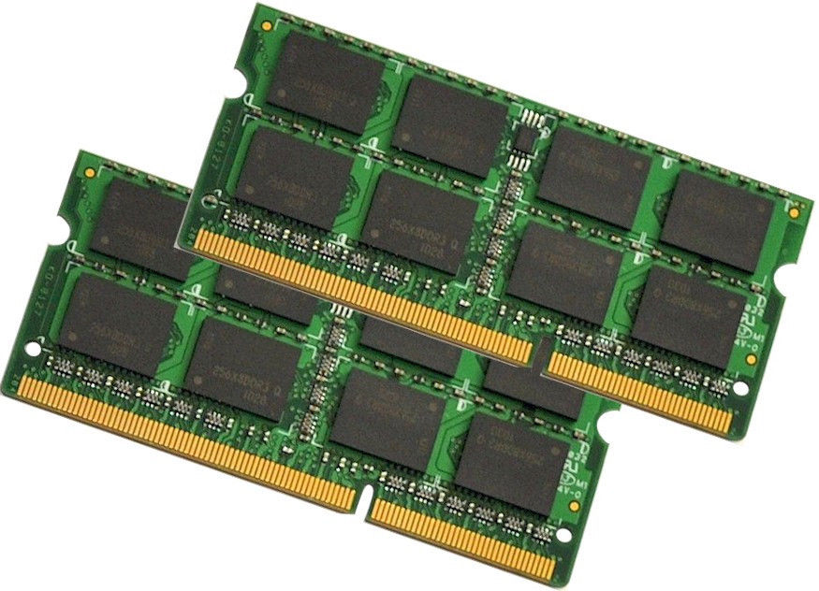
RAM
Sources: - https://goo.gl/AYLtPd (picture)
Computer A
Computer B
16 GB RAM
Most computers have 16 GB of RAM
Sufficient data processing for college use.
There are better RAM available, but it is not worth the cost.
8 GB of ram is suitable for any college student. Most college students don’t play videogames on their computers (they’re more social instead).
8 GB isn’t the superior RAM size for any computer, however, it gets the job done!
Conclusion: Computer A is more suited for data processing.

Slide 5
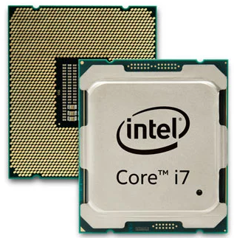
CPU
Sources: - https://goo.gl/JV9dMX (picture) - https://goo.gl/EML7Bd (info) - https://goo.gl/FgpoGw (info)
Computer B
Computer A
With 10 tabs open in Google Chrome and Microsoft Edge -- including streams from YouTube, Pandora and Netflix -- didn't experience any lag.
This computer’s CPU is called, “Qualcomm Snapdragon™ 835 Mobile Processor”. Compared to computer a’s CPU, this is not the best for performance, however, it is the best option if you’re interested in a computer that can last long (it’s metrics are superior).
Conclusion: Intel (computer a) is superior when it comes to performance, however, Qualcomm Snapdragon (computer b) is superior when it comes to it’s battery life and where most of its energy is derived into.

Slide 6

Resolution
Sources: - https://goo.gl/5ctXnm (picture)
Computer A
Computer B
13.3-inch FHD (1920x1080) Touch Display
This computer is close with computer b when it comes to its resolution, however, it beats computer b’s specs because it is touch screen which people tend to like nowadays.
13.3-inch FHD (1920x1080) No touch display
This computer is neck and neck with computer a’s resolution, however, this computer doesn’t have the capability of touch screen but computer a does!
Conclusion: Computer a beats computer b just because it has the upper hand in regards to touch screen! They both are suitable computers for anyone, but artists may prefer computer a because of its capability of a touch screen.

Slide 7

Size
Sources: - https://goo.gl/jBzedt (picture)
Computer A
Computer B
Height: 15.51 mm (0.61 inches) Width: 309.6 mm (12.19 inches) Depth: 215.7 mm (8.5 inches)
Compared to computer b’s specs, this is a tad bit larger (height), but beats b in everything else (width & depth).
Height: 1.49 cm (0.59 inches) Width: 31.6 cm (12.44 inches) Depth: 22.1 cm (8.7 inches)
Compared to computer a’s specs, this is a tad bit smaller (height), but doesn’t really win the war in everything else (width & depth).
Conclusion: Computer b is a better fit for accessibility as its battery life is longer and it doesn’t have a large height as compared to computer b. For a typical student, this would be easy to carry and manage.

Slide 8
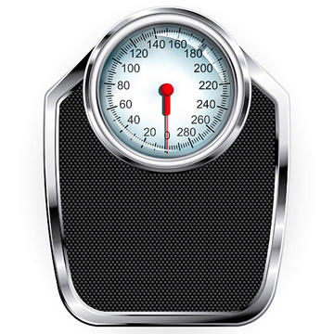
Weight
Sources: - https://goo.gl/1Kcphj (picture)
Computer A
Computer B
3.4 pounds
The weight of the computer has no correlation to the specs of the computer
The weight difference of computer A and B is negligible to humans.
Weight: 1.39 kg (3.06 pounds)
Lighter computer to carry, however, both these computers are pretty close to each other’s weight so it wouldn’t make a significant difference.
Conclusion: Computer b takes the lead for lightness of the computer. For the purpose of college use, computer B is better since you have to carry the computer to class to class

Slide 9
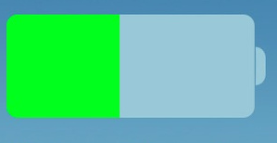
Battery Life
Sources: - https://goo.gl/3Y5woj (picture) - https://goo.gl/AnJ9ZC (info) - https://goo.gl/e1wtTn (info)
Computer A
Computer B
38 Whr, 3-Cell Battery (Integrated)
5 hr 48 min
Purchase portable charger to compensate for this difference
“Up to 22 hours battery life”.
Computer b is far superior than computer a when it comes to its battery life. This is mainly due to its processor (Qualcomm) being far superior to intel’s when it comes to where it derives its power into.
Conclusion: Computer b takes the lead here because of its amazing battery life. It has the capability of lasting over thirty days while computer a can only last for five hours and thirty two minutes.

Slide 10

Security
Sources: - https://goo.gl/ynLdHE (picture) - https://goo.gl/fFcXsy (info)
Computer A
Computer B
Windows based
The Windows operating system isn’t as secure as Linux is because it’s more general and most malware attacks on Windows computers aren’t as unique/sophisticated to create as if one were to create one for a Linux machine.
Linux based
The Linux operating system is more secure because most malware attacks on a Linux machine are unique. Window attacks ran on a Linux computer would not function properly, thus in conclusion, Linux is more of a stable operating system for users to keep private information on.
Conclusion: Computer b takes the lead on security because it’d be running a Linux operating system and it’s far more stable/secure to put personal information on to where as if put on a Windows machine, one may easily be able to steal it.

Slide 11

Operating System
Sources: - https://goo.gl/r2f4d8 (picture) - https://goo.gl/fFcXsy (info)
Computer B
Computer A
This computer is running a non popular operating system so it’d be difficult for generic users to use this computer. It does come with Windows for free, so it’d be easy to revert back to Windows when needed.
Most applications are written for WIndows, so it is easy to download
Conclusion: Computer a takes the lead for its ease of use, this is because computer a is running an operating system that is well known where as computer b’s operating system isn’t too popular and it’s sort of complicated to grasp the concept that you can get anything on a Linux machine for free!

Slide 12
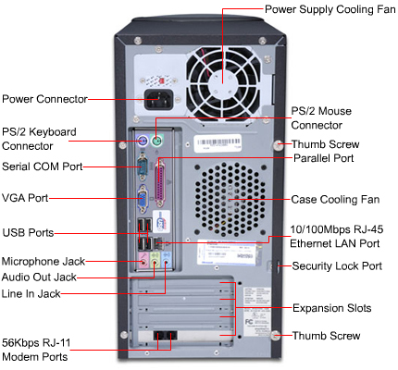
Ports
Sources: - https://goo.gl/dcVX9x (picture)
Computer A
Computer B
1 x Power 1 x USB 3.1 Gen 1 Type-C 2 x USB 3.1 Gen 1 1 x Headphone/Microphone Jack 1 x HDMI 2.0
2 USB 3.1 Gen 1 Type-A 1 Audio jack: headphone / mic-in 1 Combo Nano SIM (tray with needle) 1 MicroSD card reader slot (supports up to 256GB) 1 HDMI 1 DC in
Conclusion: Both computers have the same amount of ports (seven), besides that, it’s difficult to compare the two because it all depends on the necessity of a student (as to which ports they use and how frequently). Both computers are neck and neck when it comes to their number of ports.

Slide 13

Accessibility
Sources: - https://goo.gl/Vfg4f1 (picture) - https://goo.gl/oioYD7 (info) - https://goo.gl/QprRqP (info)
Computer A
Computer B
After we played a full-screen video for 15 minutes, the touchpad measured 88 degrees Fahrenheit, while its keyboard registered 92 degrees and the bottom hit 94 degrees
Battery life lower than average than average computer
Touch screen
This computer is very similar to computer a’s dimensions which makes it just as easy to carry as computer a.
It can fit into any backpack, but due to its battery life, it can last longer which makes a tad bit more accessible for users because unlike computer a, it won’t die on you as quickly.
Conclusion: Computer b is a better fit for accessibility as its battery life is longer and it doesn’t weigh as much as computer b does. For a typical student, this would be easy to carry and manage.

Slide 14

Final Price
Sources: - https://goo.gl/p7EqU4 (picture)
Computer A
Computer B
Total $1090.96
Computer - $1049.99
http://www.dell.com/en-us/shop/dell-laptops/inspiron-13-7000-2-in-1/spd/inspiron-13-7373-2-in-1-laptop/fncwkb001h
$1049.99
Portable charger - $29.99
https://www.bestbuy.com/site/tzumi-pocketjuice-endurance-8000-mah-portable-charger-black/5182900.p?skuId=5182900
WIREFULL MOUSE $5.99
Screen protector - 15.99 https://www.amazon.com/Fingerprint-Screen-Protector-Inspiron-Model/dp/B00NO4PNZQ
Computer bag - $18.99
https://www.amazon.com/Sleeve-Inspiron-Laptop-Accessories-NuVur/dp/B00QFS0GVE
TOTAL PRICE - $1198.97 (left with $1.04)
Computer - Click here! ($799)
Extra Storage - Click here! ($149.99)
Wireless Mouse - Click here! ($149.99)
Computer Bag - Click here! ($149.99)
Sick Glasses - Click here! ($99.99)

Slide 15
Conclusion
Nishant Srivastava
I’d choose the ASUS NovaGo TP370QL as my computer because it has surpassed the Inspiron 13 7000 2-in-1 in several ways such as its battery life (which allows the laptop to function longer than the competitor), its weight (easy to carry due to its weight), its security (less people will be able to steal my information and I wouldn’t have to worry too much about malware), and also its CPU (this laptop can last longer both internally and externally).
Along with all of the stand alone specs of this laptop, I will be purchasing a one terabyte USB 3.0 external hard drive (this will be used as my overall backup for all of my files on my laptop).
They’re both good computers, however, personally I feel like the ASUS computer would be the perfect pick for myself.

Slide 16
Conclusion
Kaito Tsumi
I am sure there are better computers than Inspiron 13 7000 2-in-1, but I can say my computer is better. Nishant lists the terminology for computer’s spec, and he does not explain what that terminology means or does to his computer. On the other, my computer’s spec as evidence. I gathered information form the users who used my computer, and how they felt about the computer. Average person has no idea what that computer’s spec through looking at the computer specific terminology. The objective of this presentation is to compare the two computers and determine which computer is better. There has to be a direct evidence to show w one computer is better than another.
My computer is better for college use: faster RAM, open multiple tabs without affecting computer’s processing speed, maintain consistent normal temperature of about 88F degrees.
If I was the customer, I would purchase a computer with details that is understandable.

Slide 17

Citations
INCLUDED IN THIS SLIDE ARE ALL THE SOURCES USED FOR THIS PROJECT (some of these may be repeated)
- https://goo.gl/wGpB2g (picture) - https://goo.gl/6V424V (picture) - https://goo.gl/uLxMv2 (info) - https://goo.gl/bnzEbK (info) - https://goo.gl/jpZoHt (Info) - https://goo.gl/AYLtPd (picture) - https://goo.gl/JV9dMX (picture) - https://goo.gl/EML7Bd (info) - https://goo.gl/FgpoGw (info) - https://goo.gl/5ctXnm (picture) - https://goo.gl/jBzedt (picture) - https://goo.gl/1Kcphj (picture)
- https://goo.gl/AnJ9ZC (info) - https://goo.gl/e1wtTn (info) - https://goo.gl/ynLdHE (picture) - https://goo.gl/fFcXsy (info) - https://goo.gl/r2f4d8 (picture) - https://goo.gl/fFcXsy (info) - https://goo.gl/dcVX9x (picture) - https://goo.gl/Vfg4f1 (picture) - https://goo.gl/oioYD7 (info) - https://goo.gl/QprRqP (info) - https://goo.gl/p7EqU4 (picture) - https://goo.gl/3Y5woj (picture)
for checking our project out
https://goo.gl/9E9tgr

